Slide 1

V
The Future of Content
Acquisition & Distribution
Notes:
Deck, Live Demo, Q&A

Slide 2

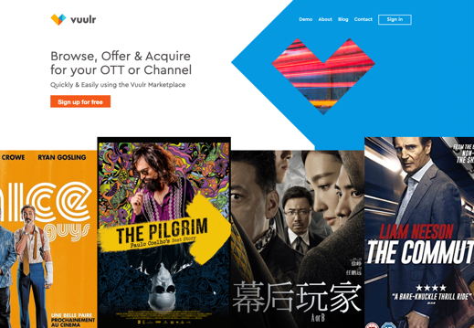
Vuulr’s Finished Content Marketplace
31,000+ Unique Titles (Film & TV)
170,000+ Hours of Content
12,000+ Users
8,000 Sellers
6,500 Buyers
11 Days – Average time to close a deal (20-40x faster!)

Slide 3
The Structure of
The Industry is Changing

Slide 4

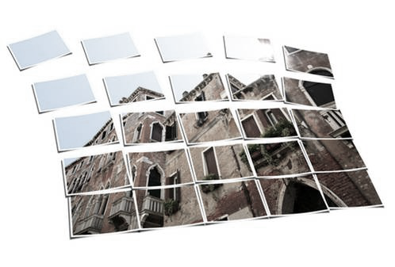
Globalisation
Audience Fragmentation
Deal Value Decline
Notes:
Parasite | Netflix buying local | Have to buy wider, to meet tastes | Streaming = borderless
Stacking subs
All Inevitable

Slide 5
Today’s Challenges
For Sellers

Slide 6
Distribution Reach

Slide 7

Monetisation of Back Catalogue

Slide 8


Deal/Opportunity Structure
From Few Large/Exclusive
to
Many but Smaller/Non-Exclusive

Slide 9
Rights Complexity

Slide 10
Pricing Model Change
Flat
Fee
Per Unique Viewer
Per
Stream
Minute
%
Revenue
Share

Slide 11
Today’s Challenges
For Buyer

Slide 12


Strategic, Data Driven & Proactive
to

Slide 13
Budget Pressure

Slide 14
Speed & Agility

Slide 15
Change in Tool Set
From Manual Selling to Digital Transactions

Slide 16

Digital Transformation
to

Slide 17

The Vuulr Digital Marketplace
Search Catalogue
Negotiate
Discover
Contract
Watch Screeners
Exchange
Connect & Chat
Rights Management

Slide 18
The Business Model
Reducing Friction

Slide 19
Sellers
Buyers
Free to Register Accounts
Free to List Catalogue (Front & Back) & Non- exclusive
Vuulr Invests its own $s Marketing
Buyers make offers Direct to Sellers
Negotiate and Agree Commercial Terms
Deal Memo Generated & Agreed
Vuulr earns 10% commission on Success
Free to Register Accounts
Aggregates Multiple Catalogues
Free to Search/Discovery
Watch Trailers & Screeners On demand
Instant Avails Check
Negotiate and Agree Commercial Terms
Deal Memo Generated & Agreed

Slide 20
Thank You
Live Demo
Q&A
Ben.Flint@vuulr.com

